Slide 1
A Community-Engaged Internship for Students from Rural Communities
Annie O. Derthick, PhD | Kalli Varaklis, MD, DIO
CMMC FMR | Maine Health
Maine Rural Graduate Medical Education (MERGE) Collaborative

Slide 2
Disclaimer
All planners, faculty, and others in control of this content have no relevant financial relationships to disclose

Slide 3
Special Thanks
PI
Kalli Varaklis, MD, MEDs, DIO
Program Manager
Dave McLellan, MBA

Slide 4
Objectives
Provide some brief background
Pathways to rural medicine
Describe the MERGE Public Health Pathway Program based on Principles of Place-Based Education
Discuss strategies for application in other settings

Slide 5
MERGE Collaborative
Rural Physician Crisis
Unique Needs of Maine
State RFP
MERGE
“Boomer” Retirement Cliff
Geography
Rural Hospital Closure
Managed Care
Expand Rural GME
Increase Access

Slide 6
MERGE Collaborative
Rural Physician Crisis
Unique Needs of Maine
State RFP
MERGE
“Boomer” Retirement Cliff
Geography
Rural Hospital Closure
Managed Care
Expand Rural GME
Increase Access

Slide 7
MERGE Collaborative
Rural Physician Crisis
Unique Needs of Maine
State RFP
MERGE
“Boomer” Retirement Cliff
Geography
Rural Hospital Closure
Managed Care
Expand Rural GME
Increase Access

Slide 8
Tom Gearnan, MD, Associate DIO
Annie Derthick, PhD, Academic APD
Kate Hoffman, DO, Program Director
Jim Jarvis, MD, DIO
Kalli Varaklis, MD, DIO (PI)

Slide 9
Deliverables
Create 4 Rural Rotation Sites
Provide Quality Faculty Development
Create a State-Wide Learning Platform
Develop and Host an Annual Conference
Establish a Medical Student Pipeline

Slide 10
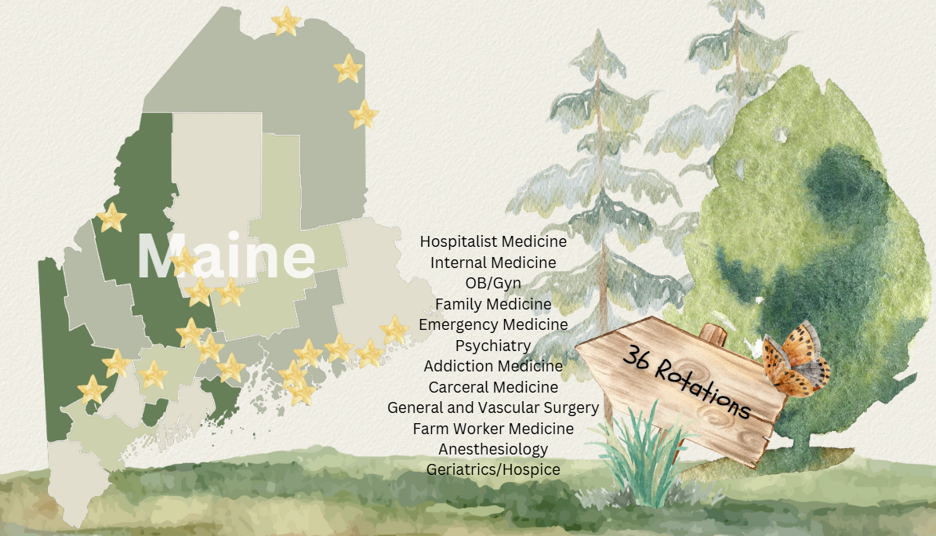
Rural Rotations

Slide 11
Rural Medical Student Education
Recruit from Within
>5% of students are from rural areas^{2,3}
Beyond Clerkships
Innovation is needed for those with “great potential for contributing to the health of rural communities”⁴
Rural Communities Want More Than a Doctor
They are asking for providers to integrate into the fabric of their lives^{4,5}
Importance of Advocacy Education
Primary care is strategically positioned to be agents of change, yet medical students report feeling underprepared^{6,7}

Slide 12
Rural Medical Student Education
Recruit from Within
>5% of students are from rural areas^{2,3}
Beyond Clerkships
Innovation is needed for those with “great potential for contributing to the health of rural communities”⁴
Rural Communities Want More Than a Doctor
They are asking for providers to integrate into the fabric of their lives^{4,5}
Importance of Advocacy Education
Primary care is strategically positioned to be agents of change, yet medical students report feeling underprepared^{6,7}

Slide 13
Place-Based Education⁸
The local community is the starting point
Emphasizes hands-on, real-world learning
Creates a heightened sense of commitment to serving as active, contributing citizens

Slide 14
PBE and Problem-Based Learning
Deep Dive into the topic or problem
Culminating in a project or presentation
Intended for an audience outside of the classroom

Slide 16
Place-Based Learning Dimensions | Principles of Adult Learning
Learning is focused on a specific problem through which students learn about wider fields of knowledge | Adults learn best when the learning is problem-centered and focused on real-world issues
Students create, not consume knowledge | Adults learn through hands-on experiences
Teachers guide, not lead | Adults learn best when they are intrinsically motivated
Content is selected by learners Content is based on student interests and questions | Adults are self-directed
Real-World application | Adults are ready to learn when they perceive a need for new skills Adults want to know why they are learning something
Aims to break boundaries between classroom and community | Adults rely on experience to facilitate learning

Slide 17
The MERGE Public Health Internship
4-week Immersive Internship

Slide 18
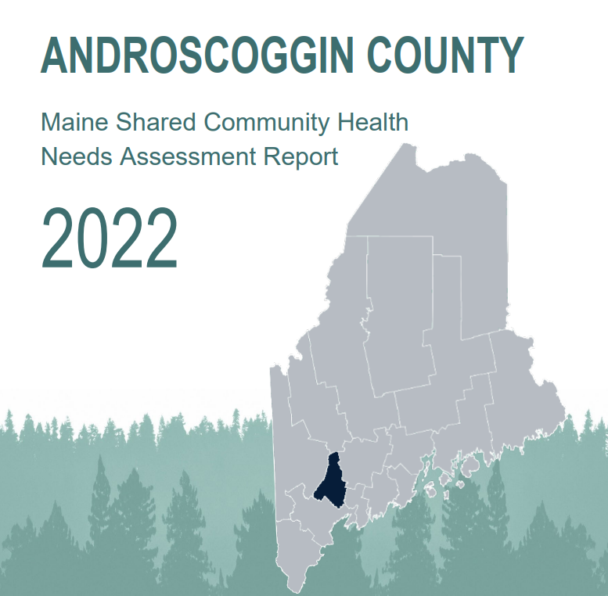
Community Health Needs Assessment
Interns read the CHNA & Pick a topic
Work with the local community under guidance from a mentor
Produce a policy brief to inform a wider audience
Produce a poster for an academic audience

Slide 19
Other Details
Research Mentor
Cohort
MERGE Conference
Lessons Learned
Topic Selection
Payment Models

Slide 20
Outcomes
2023
2024
6 applications
5 from ME, 1 from CT
3 UNECOM, 1 Tufts ME Track
11 applications
11 from ME
1 UNECOM, 2 Tufts ME Track, 1 Brown University

Slide 21
Payment Models
2023
2024
Seasonal Employees
$22/hr
40hrs/week
Submitted timesheets
~ $5000/intern
Independent Contractor
$7000/intern paid at beginning
2025
Independent Contractor
$6000/intern paid at beginning

Slide 22
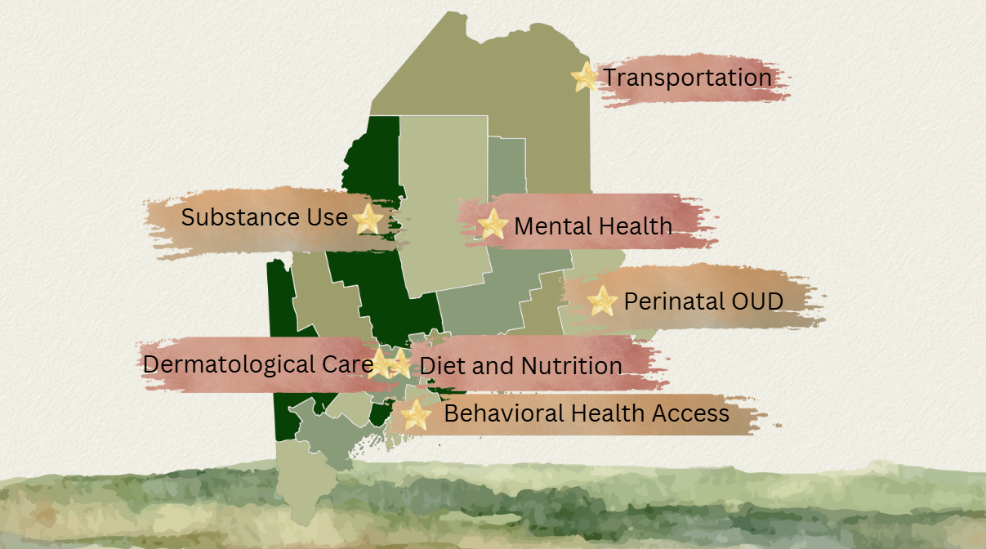
Direct Community Impact

Slide 23
Application in Other Settings
Identify opportunities for students to immerse themselves in the community
Incorporate the CHNA into curricular design and learning activities
Prioritize “products” that serve the community rather than academic audience

Slide 24
Discussion
What elements of this place-based learning student pipeline are feasible for you to implement in your system?
How can you more intentionally incorporate the local CHNA into medical student education?
For more information: www.mergecollaborative.org
Annie Derthick: derthian@cmhc.org
907-887-9004

Slide 26
References
1. Ledford CJW, Guard EL, Phillips JP, Morley CP, Prunuske J, Wendling AL. how medical education pathways influence primary care specialty choice. Fam Med. 2022 Jul;54(7):512-521. doi:10.222454/FamMed.2022.668498. PMID: 3583391.
2. Rabinowitz HK, Paynter NP. The role of medical school in rural graduate medical education: Pipeline or control valve? J Rural Health. 2000 Summer;16(3):249-53. doi:10.111/j.1748-0361.2000tb00468.x. PMID: 11131769.
3. Shipman SA, Wendling A, Jones KC, Kovar-Gough I, Orlowski JM. The decline in rural medical students: A growing gap in the geographic diversity threatens the rural physician workforce. Health Aff (Millwood). 2019 Dec;38(12):2011-2018. doi:10.377/hlthaff.2019.00924. PMID:31794312
4. Longnecker RL, Andrilla CHA, Jpson AD, Evans DV, Schmitz D, Larson EH, Patterson DG. Pipelines to pathways: Medical school commitment to producing a rural workforce. J Rural Healht. 2021 Sep;37(4):723-733. doi:10.1111/jrh.12542. Epub 2020 Nov 26. PMID: 33244824.
5. Shanoor S. Practicing medicine in Rural America: Listening to primary care physicians. Commonwealth Fund. Feb. 6, 2019. https://doi.org/10.26099/3n8m-qk97
6. Ohta R, Sano C. Enhancing rural health dialogue: The crucial role of reflective practice in family physician involvement. Cureus. 2023 Nov 6;15(11):e48380. doi:10.7759/cureus.48380. PMID: 38068724.
7. Aliani R, Dreiling A, Sanchez J, Price J, Dierks MK, Stoltzfus K. Health advocacy and training perceptions: A comparison of medical student opinions. Med Si Educ. 2021 Aug 24;31(6):1951-1956. dio:10.1007/s40670-021-01394-9. PMID: 34956706.
8. Sobel D. Place-based education: Connecting classroom and community. Nature & Listening. 2004. 22(3)312-29.
9. Yemini M, Engle L., & Ben Simon A. Place-based education: A systemic review of the literature. Ed Rev. 2022. doi:10.1080/00131911.20232177260

