Slide 1
The MERGE Collaborative Leveraging Graduate Medical Education to meet Rural Maine Healthcare Needs
Kalli Varaklis, MD, MSEd
PI, MERGE Collaborative
MaineHealth Designated Institutional Official

Slide 2
MERGE Collaborative
Mission: To collaborate to create a state-wide infrastructure for the purpose of increasing access to high quality GME rural training
Funded by a generous grant from the Maine Department of Health and Human Services
January 1, 2023 – December 31, 2024

Slide 3
Five MERGE Deliverables
New MERGE Collaborative
4 New rural GME elective rotations
Rural learning platform
Faculty Development including innovative ‘Rural Education and Leadership Academy’
Pipeline Development

Slide 4
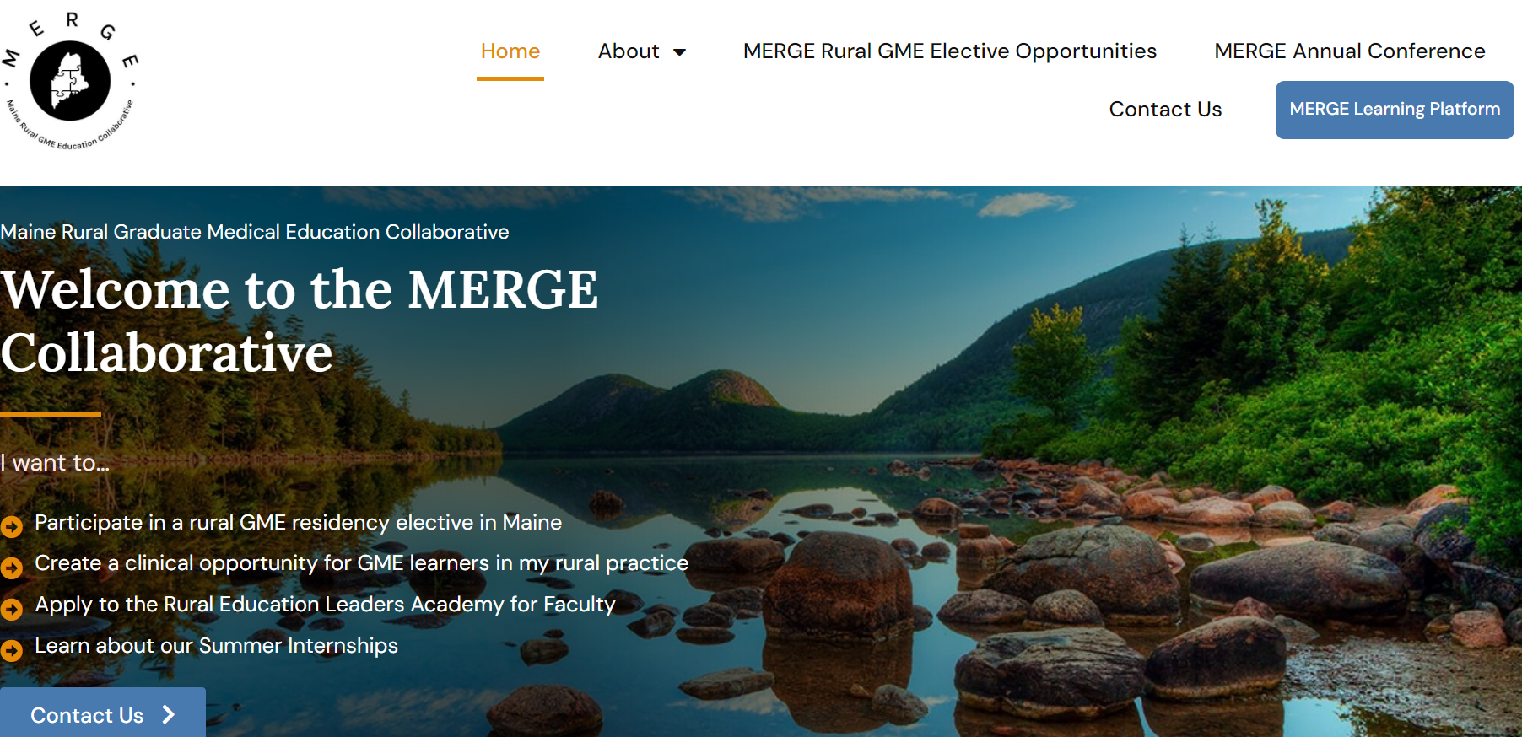

Slide 5
New MERGE Collaborative
Collaborative of 4 Maine-based GME institutions co-creating new rural GME rotations
High quality, competency-based, common evaluations
Executive committee
Oversight, guidance and adherence to mission
Collaborative strategic planning

Slide 6
Five MERGE Deliverables
4 New rural GME elective rotations

Slide 7
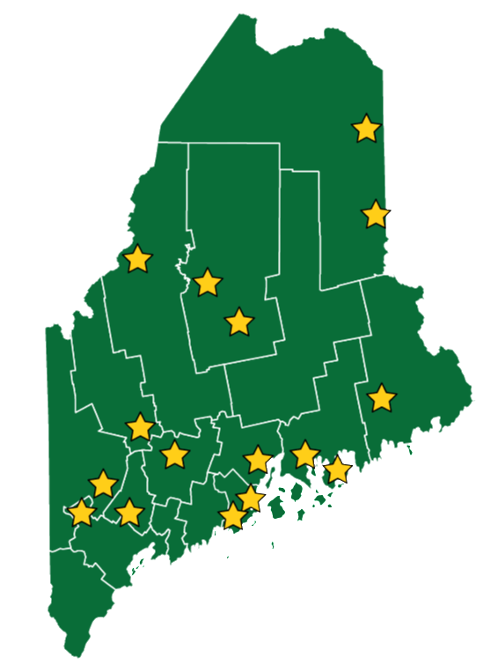
35 new rural rotations
13 different specialties
Hospitalist Medicine
Internal Medicine
Ob/Gyn
Family Medicine
Pediatrics
Direct Primary Care
Emergency Medicine
Psychiatry
Addiction Medicine
Geriatrics
Carceral Medicine
General and Vascular Surgery
Farmworker Health

Slide 8
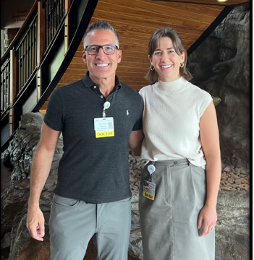
GME Learners...
First rural elective launched July 2023 (when academic schedules for 23/24 had already been established….)
In 19 months…
45 Rural elective rotations completed
12 more scheduled already for 2025
Marketing to residents within Maine and Maine medical students doing residency training outside of Maine
Dr. Rachel Heuer, MMC IM
Dr. Steve Goss, IM Hospitalist, Franklin

Slide 9
Outcome data
10 residents who have completed a MERGE elective graduated June 2024
60% (6) are practicing in rural areas
Maine – Redington Fairview in Skowhegan
Maine – Mount Desert Island Hospital in Bar Harbor
Minnesota (“My positive experience with MERGE had a big impact on my decision”)
Montana (moving closer to family)
Indian Health Service
Rural Ontario, Canada
2 are working in Lewiston (not technically rural, but serving rural patients)
2 are doing a fellowship (one planning to return to Maine)

Slide 10
Outcome data – is MERGE working to retain physicians practicing in rural Maine?
It’s too soon to tell…
Only 19 months since the first elective rotation
Likely attracting residents already interested in rural practice
Which is fine – the elective may be helping assuage concerns residents have about working in rural settings
MERGE may never be able to claim causative link
But we’ll try ☺

Slide 11
Five MERGE Deliverables
Rural learning platform

Slide 12
Interprofessional Healthcare Education Learning Platform for Maine (iHELP-ME)
Learning platform developed to serve all rural healthcare learners, teachers and preceptors
Resources focused on rural, medically-underserved and Maine-specific resources
DEI resources
Co-created in partnership with Building-ME grant
Housed on CanvasTM accessible from the MERGE Collaborative website Merge Collaborative – Maine Rural Graduate Medical Education Collaborative

Slide 13
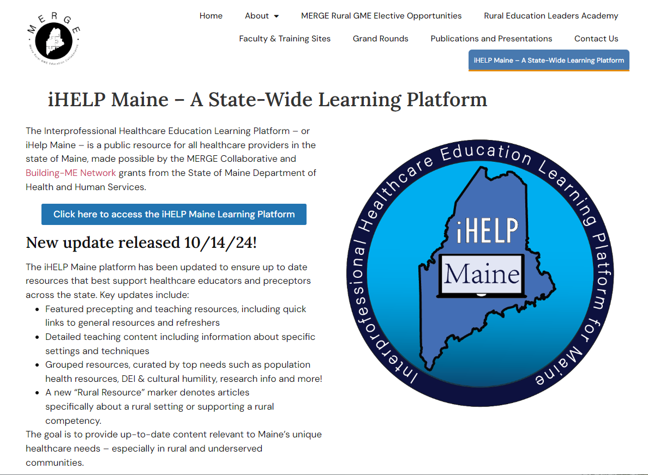

Slide 15
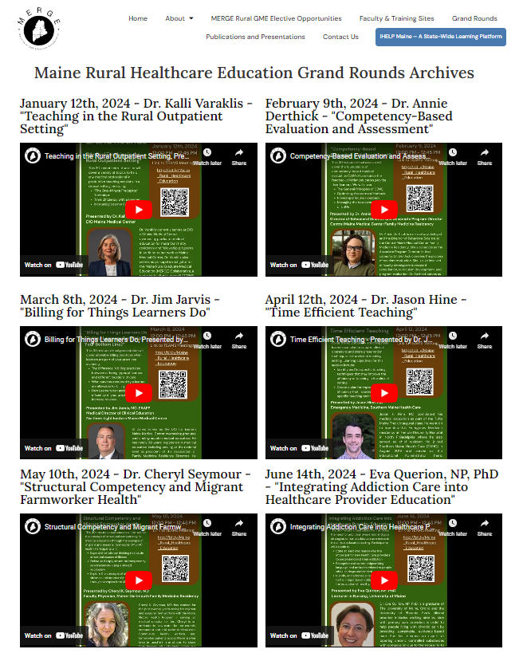
Maine Rural Healthcare Education Grand Rounds
Monthly Grand Rounds
Archived
Free CME
Interprofessional content
“Virtual Connects”
Maine Medical Center weekly Internal Medicine Grand Rounds link shared broadly
Oncology Grand Rounds link

Slide 16
Five MERGE Deliverables
Rural Faculty Development including innovative ‘Rural Education and Leadership Academy’

Slide 17
Co-Directors: Annie Derthick, PhD Associate Program Director, FM Residency, CMMC Kalli Varaklis MD, MSED DIO MaineHealth
First longitudinal cohort included 7 rural physician faculty and 3 interprofessional members creating a rural faculty learning community
These faculty were subsidized over 18 months to:
Attend competency-driven education, leadership and mentoring sessions
Develop and execute a medical education scholarly project to benefit rural learners
Rural Education Leaders Academy
(RELA)
Develop local rural education leaders who can advocate for medical education

Slide 18
Co-Directors: Annie Derthick, PhD Associate Program Director, FM Residency, CMMC Kalli Varaklis MD, MSED DIO MaineHealth
SECOND cohort started January 2025
Rural Education Leaders Academy
(RELA)
Course modified from 18 months to 12 months
4 in-person sessions
Scholarly project is a medical education quality improvement project

Slide 19
Faculty Development to support Rural Practitioners teach and precept GME learners
“GME Slam” faculty development presentation for new preceptors
Includes “Teaching the iGEN learner”
MERGE Collaborative monthly Grand Rounds
MMC Internal Medicine Grand Rounds link weekly
MH Oncology Grand Rounds link monthly

Slide 20
Five MERGE Deliverables
Pipeline Development

Slide 21
Summer internships for medical students engaged in rural research
4 students each year (2023 and 2024) selected a top healthcare concern for their rural county (Maine CHNA reports)
Prepared a policy brief for local healthcare leaders, and present poster at MERGE Collaborative conference
Support for one post-graduate student at Muskie School of Public Health
Supporting
Pipeline

Slide 22
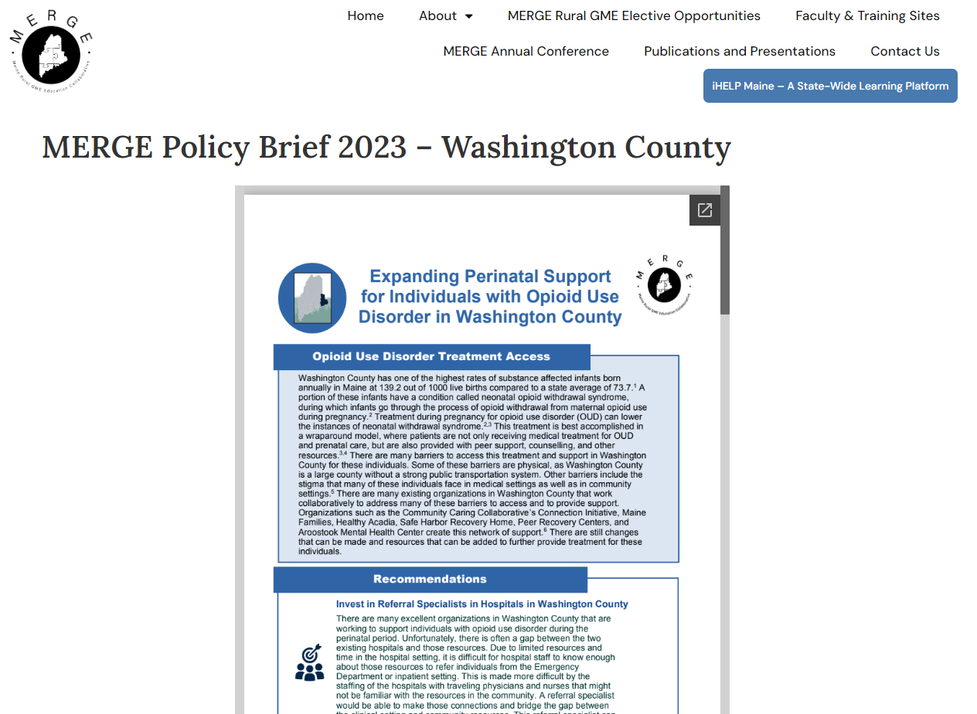

Slide 23
Rural Northern Borders HRSA grant
Award received in October 2024
Develop “Rural Obstetrics Training Intensive”
Longitudinal rural OB training rotations
6 partners across Maine and NH (so far)
Develop rural Ob curriculum to accompany rural OB clinical training, mentorship and education
Informed by patients and providers

Slide 24
Funding Updates
Received funding from the Peter and Carmen Lucia Buck Foundation (PCLB) to support the 2024 internship and RELA programs.
This helps support the internship and RELA in 2025
Will be re-applying for next year
Received funding from AgingME2 HRSA GWEP grant for an educational specialist to develop Geriatric curriculum for learning platform

Slide 25
MERGE Collaborative Next steps…
Continue developing GME rural rotations
Focus on Northern Maine – 3 additional rotations in development
Hematology/Oncology rural rotation
Geriatrics interprofessional learning initiative
Continue to recruit learners
Training in Maine, Mainers training outside of Maine
Acad Med 2018: “….a rural upbringing was the most common predictor of entering rural practice”
Evaluate learner and faculty feedback to improve educational experiences
Sustainability funding….

Slide 26
Scholarly Activity
RELA Scholars scholarly project completion
Scholarly presentations and publications
Northern New England Co0P Practice and Community Based Research Network conference (January 2025)
Invited editorial “Journal of Maine Medical Center” February 2025
STFM Conference for Medical Student Education January 2025
Medical student policy brief project
New England Rural Health Association presentation (fall 2023)
Maine Hospital Association conference(June 2024)
RELA project is innovative, publication

Slide 27
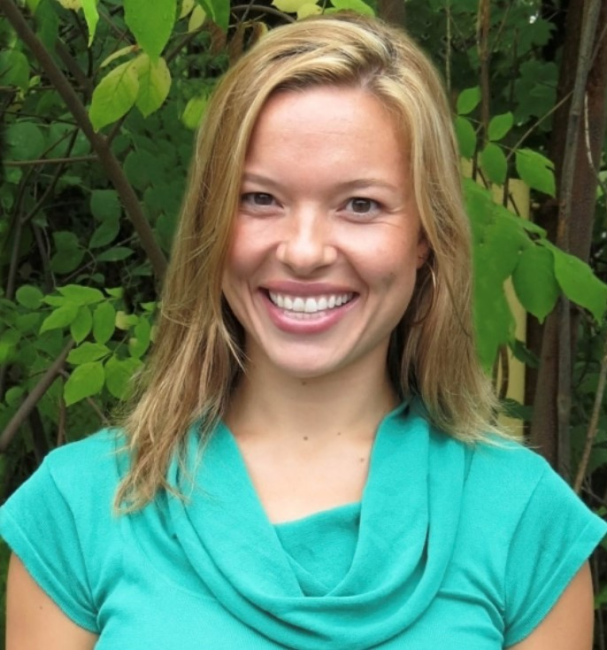
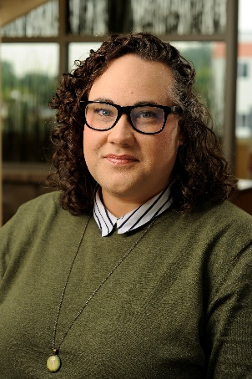
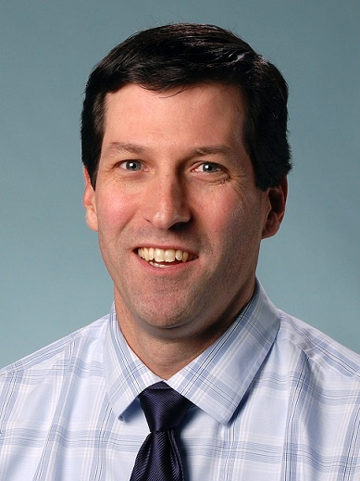
Thank you! MERGE GME Directors
Dr. Kate Hoffmann
MD-FMR Program Director
Annie Derthick, PhD Associate Program Director, FM Residency
RELA Co-Director
Tom Gearan, MD
Associate DIO
MMC-MaineHealth
Jim Jarvis, MD
DIO EMMC Northern Light Health
David McLellan
Program Manager

Slide 28
Questions?

